Slide 1
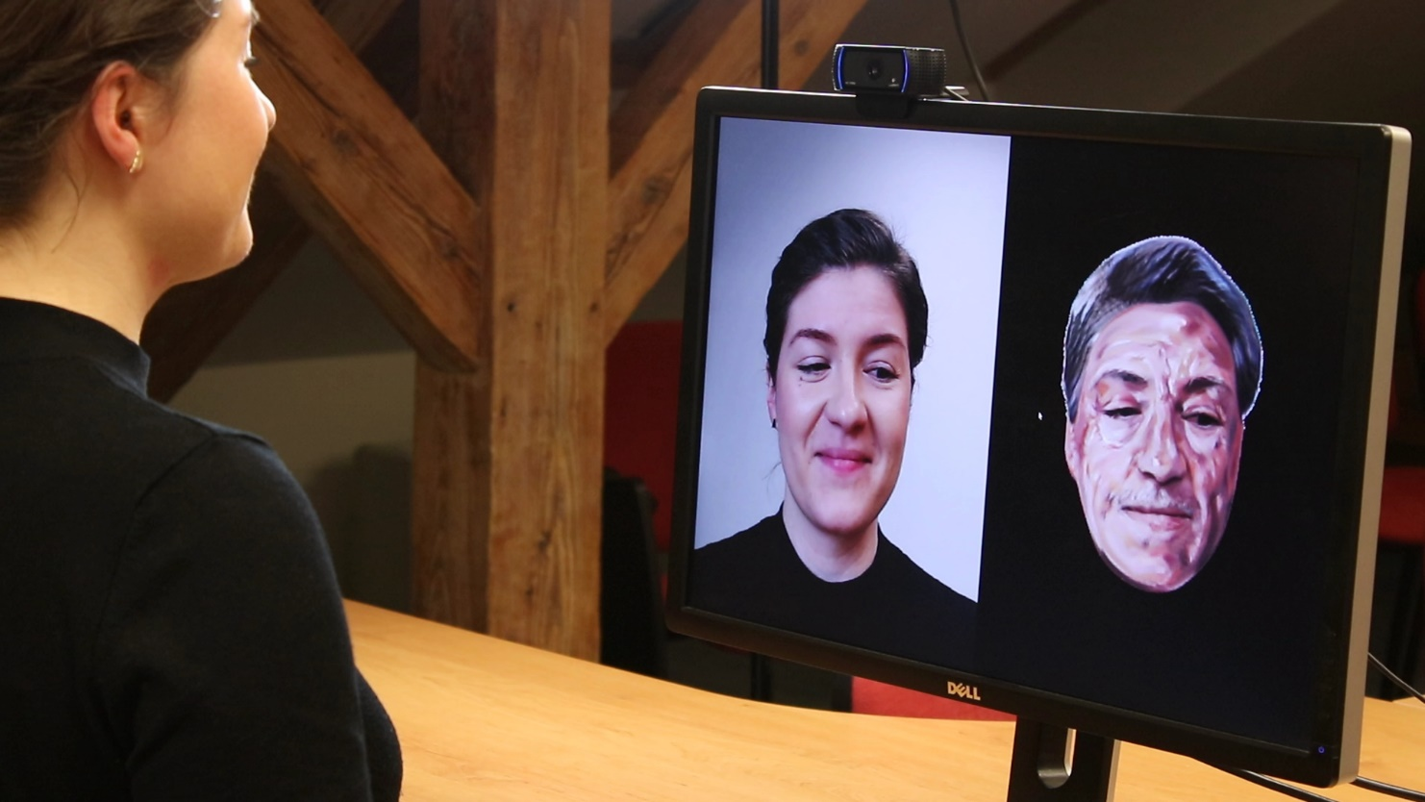


Real-Time Patch-Based Stylization of Portraits Using Generative Adversarial Network
1
2
D. Futschik¹, M. Chai², C. Cao², C. Ma², A. Stoliar²
S. Korolev², S. Tulyakov², M. Kučera¹, D. Sýkora¹
CTU in Prague, FEE
Snap Inc.

Slide 2
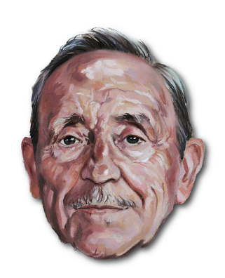

Style Transfer to Facial Videos
?
Style Exemplar
Target Video

Slide 3
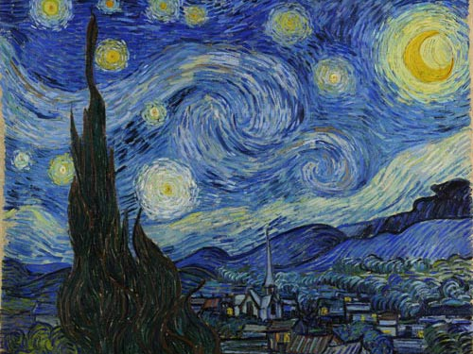
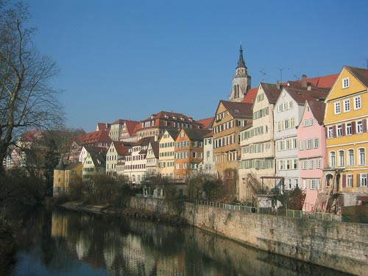


Neural-based Style Transfer [Gatys et al. 2016]
$$style$$
CNN
Style Exemplar
CNN
$$content$$
Target Scene
Notes:
Here, the authors use a deep neural network to build the representation of both style and content images…
…and then the output is created via an optimization process that minimizes the differences between the output and both input images.

Slide 4
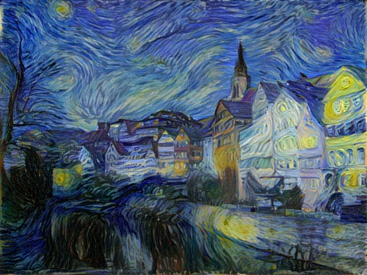



Neural-based Style Transfer [Gatys et al. 2016]
$$style$$
CNN
$$≈$$
Style Exemplar
$$F$$
CNN
$$≈$$
Output Image
CNN
$$content$$
Target Scene
Notes:
Here, the authors use a deep neural network to build the representation of both style and content images…
…and then the output is created via an optimization process that minimizes the differences between the output and both input images.

Slide 5
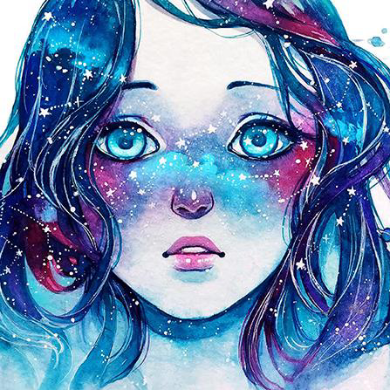
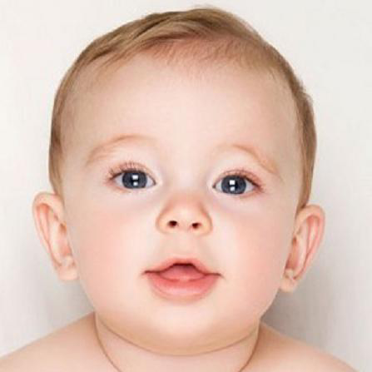
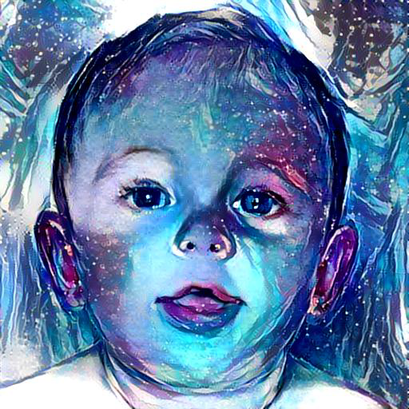
Drawback of Neural-based Style Transfer
It uses only global “statistics” = transfer is not semantically meaningful:
Style Exemplar
Target Image
Gatys et al. [2016]

Slide 6
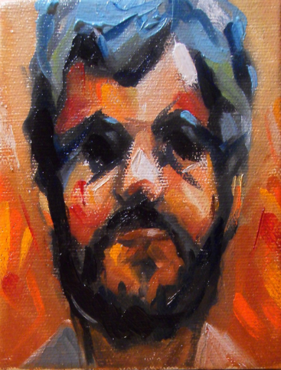
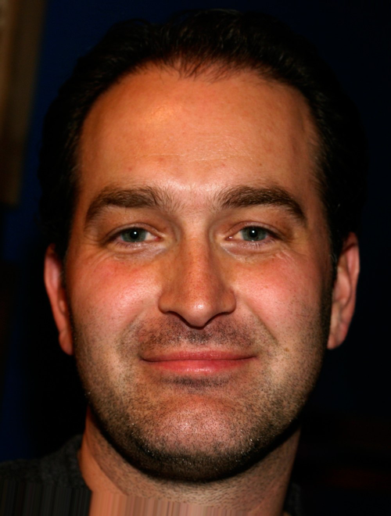
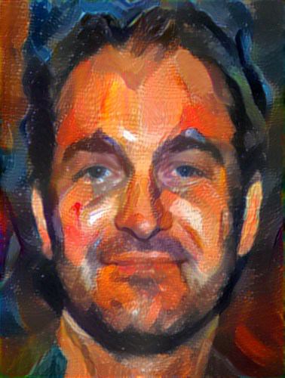
Drawback of Neural-based Style Transfer
Style specific low-level details are not preserved:
Style Exemplar
Target Image
Selim et al. [2016]
Notes:
Many of these results looked really impressive, …
…so naturally we were curious how would it work in our scenario.

Slide 7
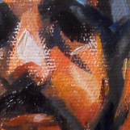
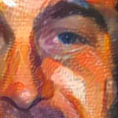
Drawback of Neural-based Style Transfer
Style specific low-level details are not preserved:
Style Exemplar
Selim et al. [2016]
Notes:
Many of these results looked really impressive, …
…so naturally we were curious how would it work in our scenario.

Slide 8
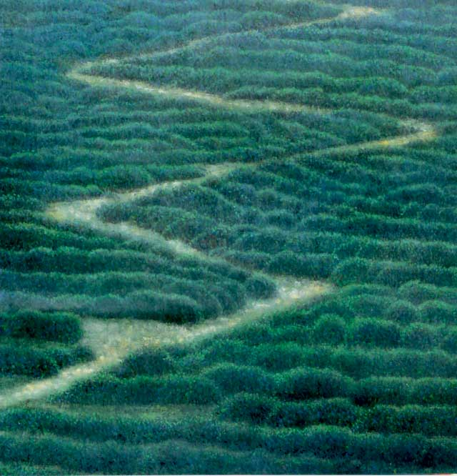
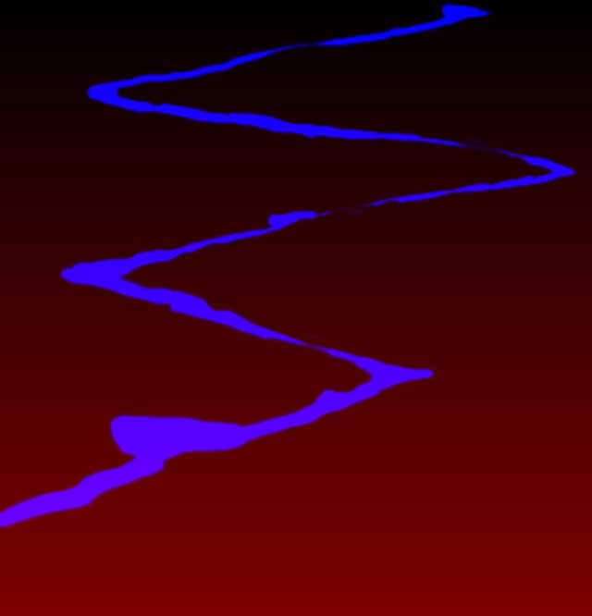
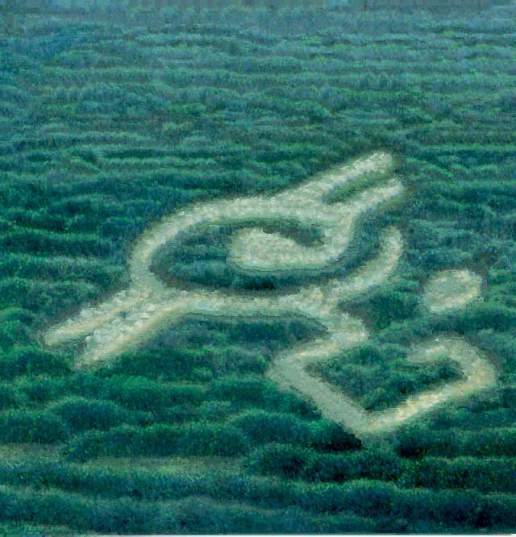





Image Analogies [Hertzmann et al. 2001]
$$S$$
$$S′$$
$$T$$
$T$’
Transfer is semantically meaningful thanks to guidance S’ and T’
Low-level details are preserved by copying patches from S to T

Slide 9
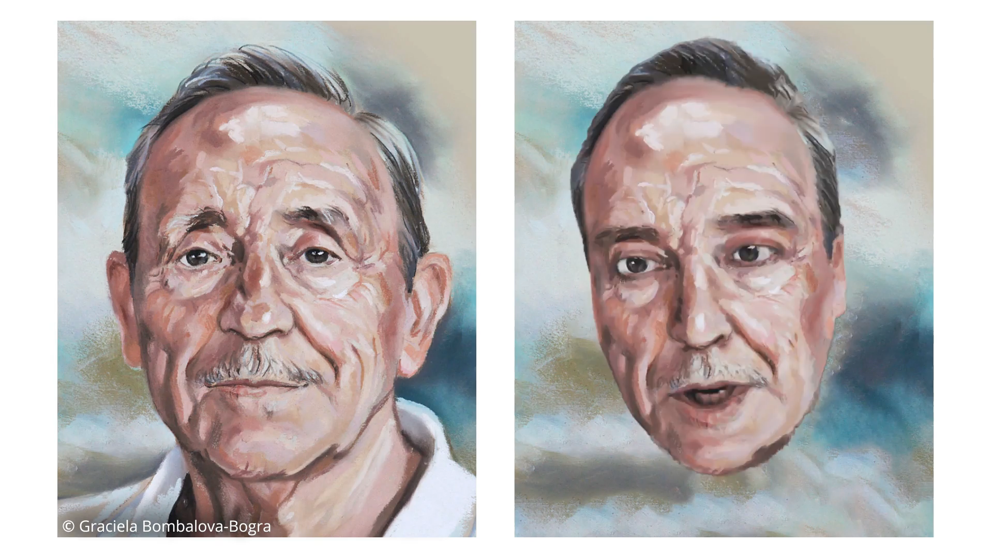
Guided Patch-based Synthesis [Fišer et al. 2017]

Slide 10

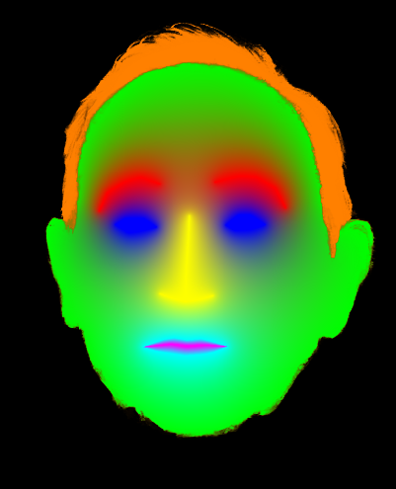
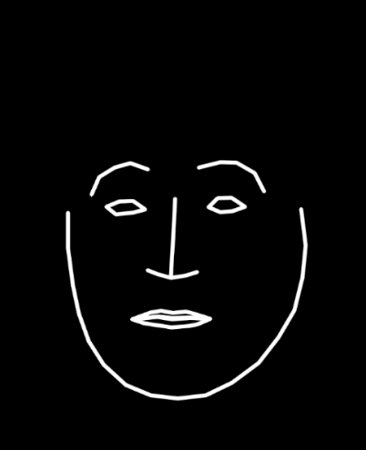
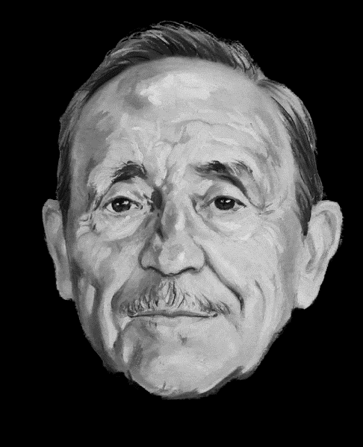
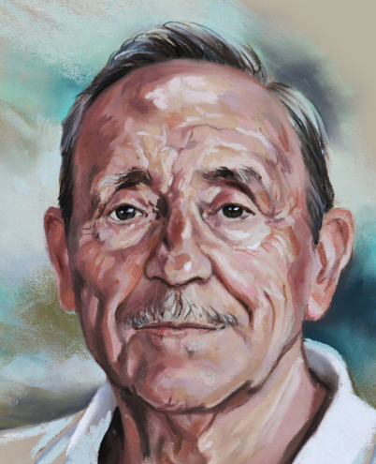
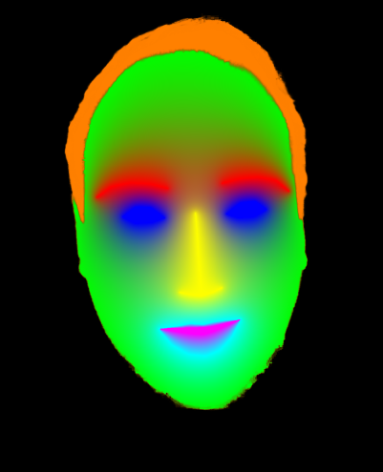
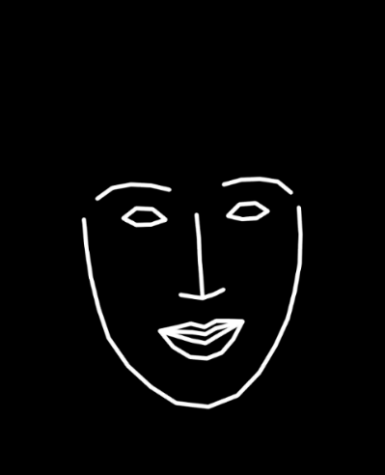
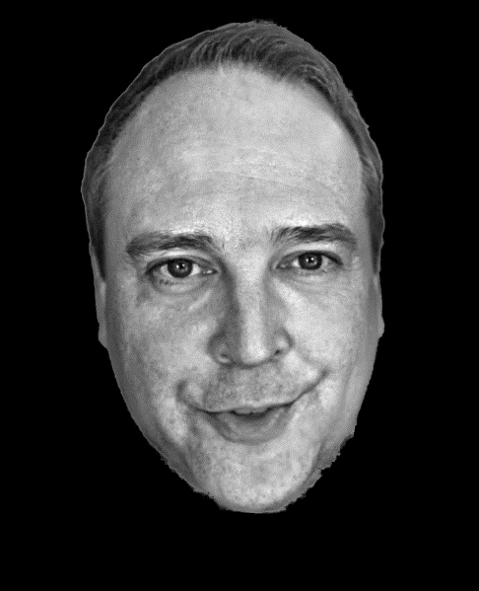
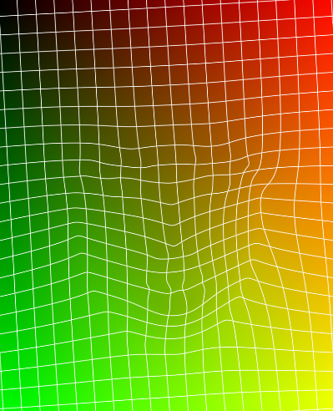
Drawback of Guided Patch-based Synthesis
Explicit guidance is needed:
source
:
?
target
:

Slide 11
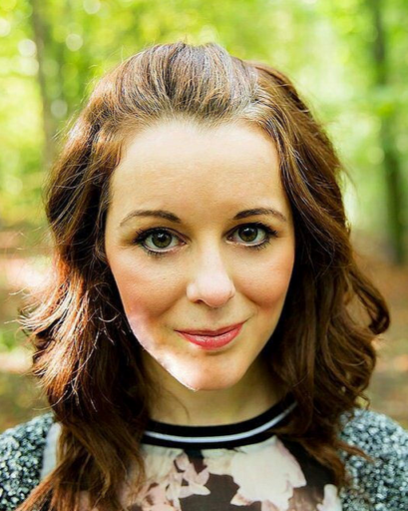
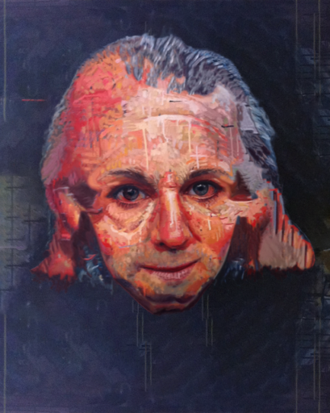
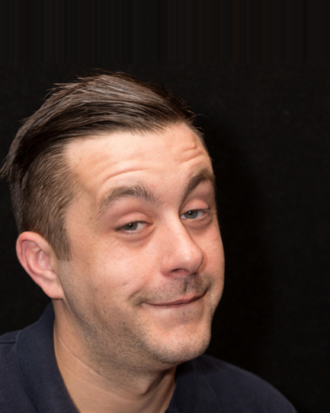
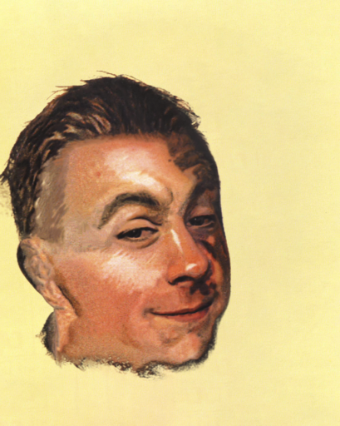
Drawback of Guided Patch-based Synthesis
The algorithm is slow and fragile:
Target Image
Fišer et al. [2017]
Target Image
Fišer et al. [2017]

Slide 12


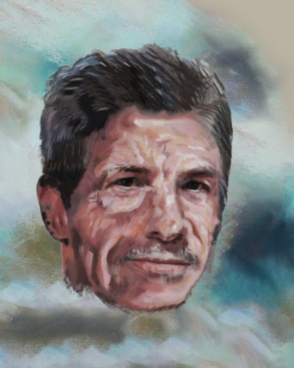
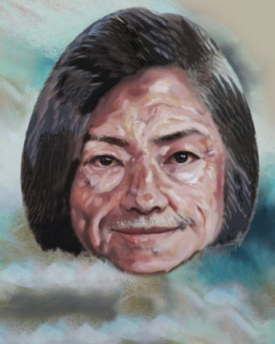
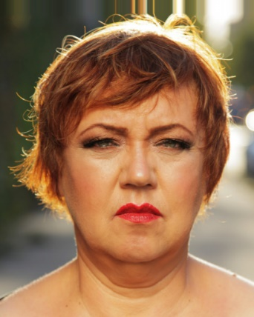

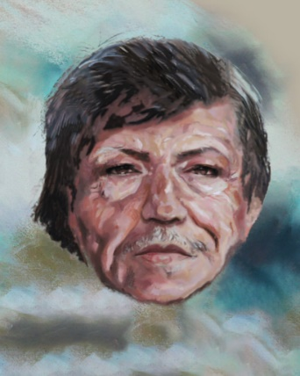
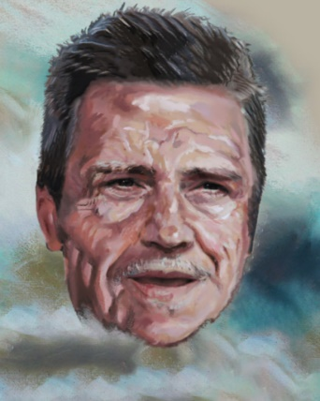
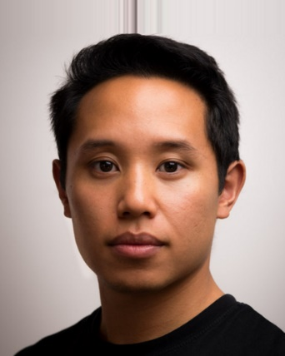
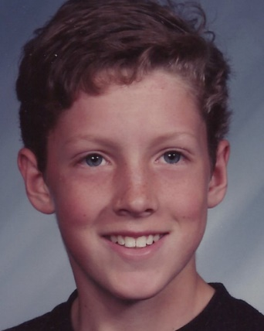
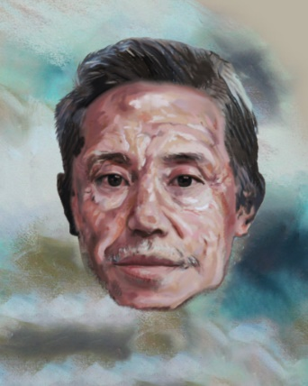
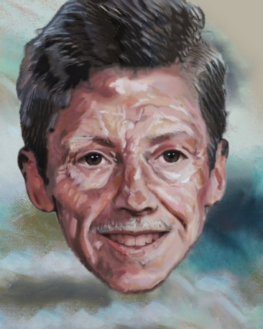
Our Approach
Training
Encoder
Decoder

Slide 13
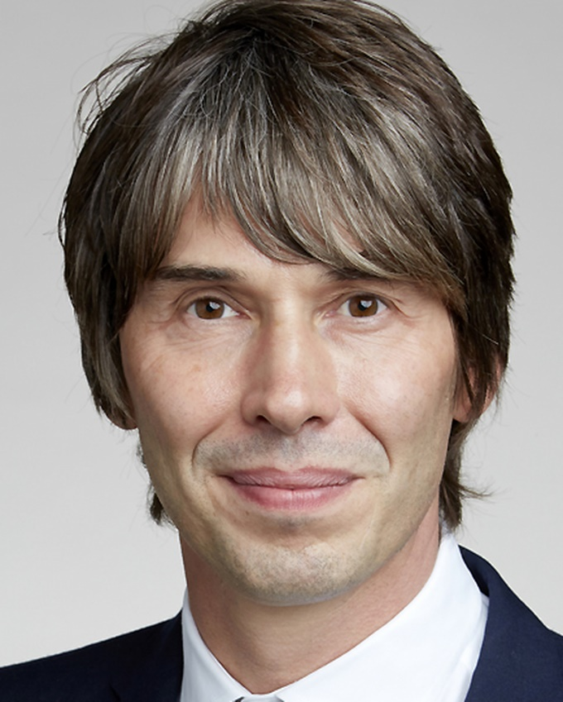
Image-to-Image Translation
Inference
?
Encoder
Decoder

Slide 14

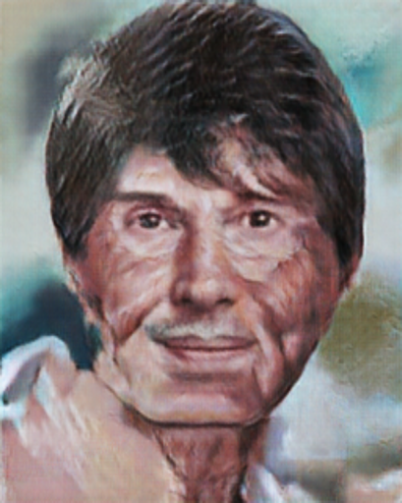
Image-to-Image Translation
pix2pix
Target Image
Style Exemplar
Isola et al. [2017]

Slide 15
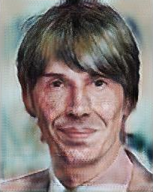
Image-to-Image Translation
starGAN
Target Image
Style Exemplar
Choi et al. [2018]

Slide 16
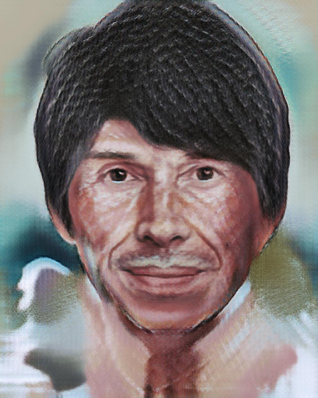
Image-to-Image Translation
pix2pixHD
Target Image
Style Exemplar
Wang et al. [2018]

Slide 17
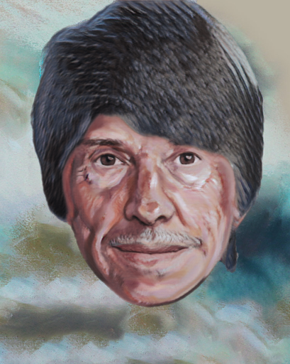
Drawback of Image-to-Image Translation
Style specific low-level details are not preserved:
Patch-based
pix2pix
starGAN
pix2pixHD
Fišer et al. [2017]
Isola et al. [2017]
Choi et al. [2018]
Wang et al. [2018]

Slide 18
Our Goals
Image-to-image framework which can reproduce low-level details with quality comparable to patch-based synthesis:
Improve network architecture
Improve loss function

Slide 19
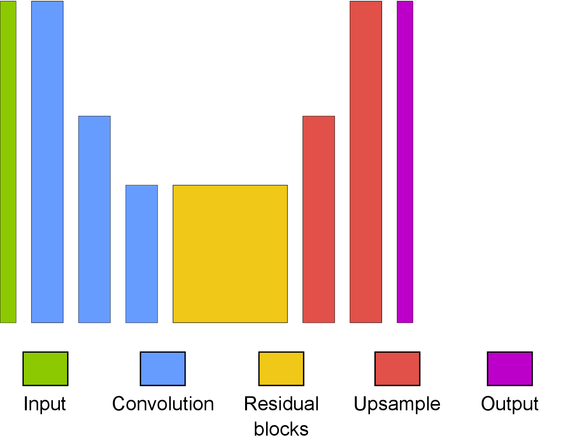
Network Architecture
Johnson et al. [2016]

Slide 20
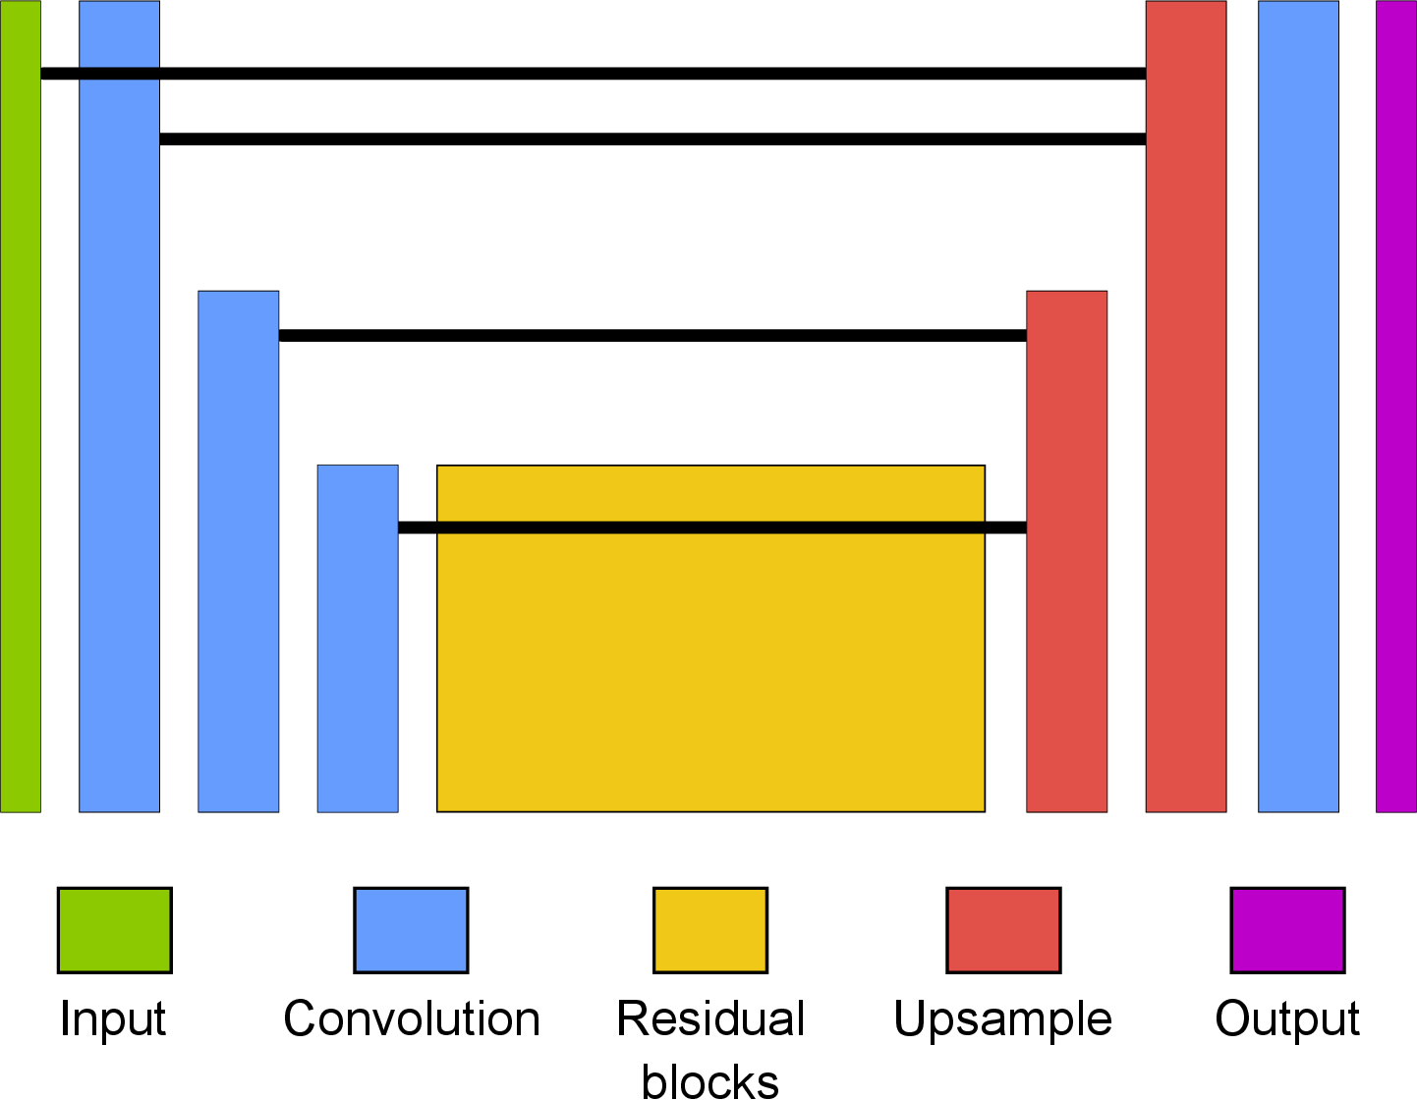
Network Architecture

Slide 21
Network Architecture

Slide 22
Loss Function

Slide 23
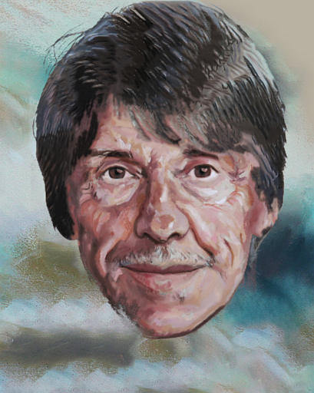
Loss Function
✓

Slide 24
Loss Function
-
|
|

Slide 25
Loss Function
Isola et al. [2017]

Slide 26
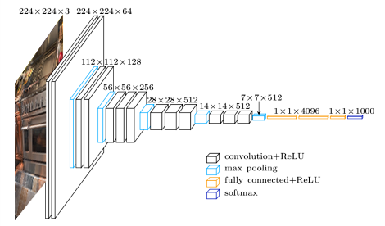
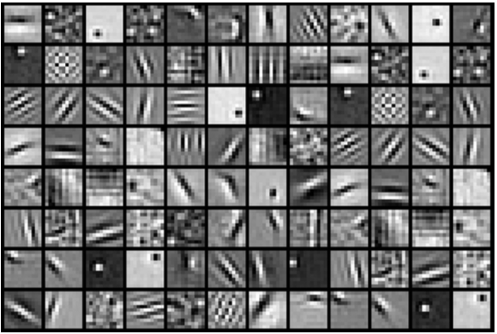
Loss Function
Wang et al. [2018]

Slide 27
Loss Function
Wang et al. [2018]

Slide 28
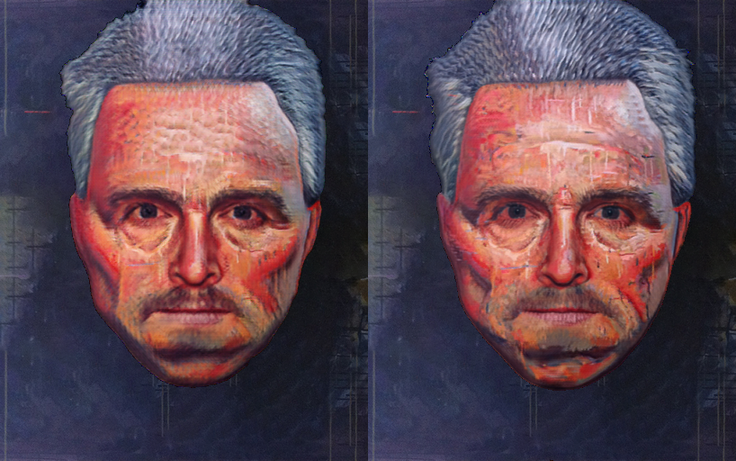
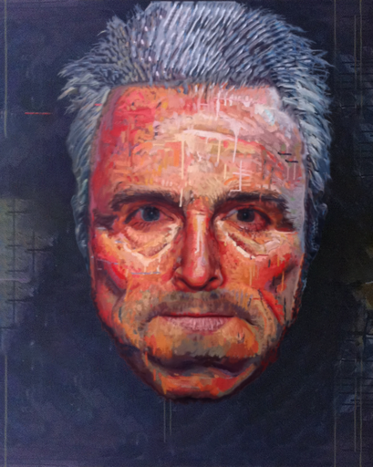
Comparison of Network Architectures
Johnson et al. [2016]
Our architecture
Patch-based synthesis

Slide 29








Comparison of Network Architectures
Johnson et al. [2016]
Our architecture
Patch-based synthesis
Style exemplar

Slide 30


Comparison of Loss Functions
Without VGG loss
With modified VGG loss
Patch-based synthesis

Slide 31


Comparison of Loss Functions
Without VGG loss
With VGG loss
Patch-based synthesis
Style exemplar

Slide 32







Results
Training dataset: 5124 pairs (photo/stylized photo)
Network input/output resolution: 512x512
Size of the resulting model: 47 MB
Training time on NVIDIA Tesla V100: 1.5 days (per model)
Model evaluation on NVIDIA RTX 2080 Ti: 60 ms (15 fps)
Number of trained models: 7 (one model per style)

Slide 33














Examples of Varying Quality in Training Dataset

Slide 34

Results
Target Image
Our Approach
Result of Fišer et al. [2017]

Slide 35
Results
Target Image
Our Approach
Result of Fišer et al. [2017]

Slide 36

Results
Target Image
Our Approach
Result of Fišer et al. [2017]

Slide 37

Results
Target Image
Our Approach
Result of Fišer et al. [2017]

Slide 38

Results
Target Image
Our Approach
Result of Fišer et al. [2017]

Slide 39
Results
Target Image
Our Approach
Result of Fišer et al. [2017]

Slide 40

Results
Target Image
Our Approach
Result of Fišer et al. [2017]

Slide 41

Results
Target Image
Our Approach
Result of Fišer et al. [2017]

Slide 42
Results
Target Image
Our Approach
Result of Fišer et al. [2017]

Slide 43

Results
Target Image
Our Approach
Result of Fišer et al. [2017]

Slide 44

Results
Target Image
Our Approach
Result of Fišer et al. [2017]

Slide 45
Results
Target Image
Our Approach
Result of Fišer et al. [2017]

Slide 46

Results
Target Image
Our Approach
Result of Fišer et al. [2017]

Slide 47
Results
Target Image
Our Approach
Result of Fišer et al. [2017]

Slide 48

Results
Target Image
Our Approach
Result of Fišer et al. [2017]

Slide 49

Results
Target Image
Our Approach
Result of Fišer et al. [2017]

Slide 50

Results
Target Image
Our Approach
Result of Fišer et al. [2017]

Slide 51
Results
Target Image
Our Approach
Result of Fišer et al. [2017]

Slide 52

Results
Target Image
Our Approach
Result of Fišer et al. [2017]

Slide 53
Results
Target Image
Our Approach
Result of Fišer et al. [2017]

Slide 54

Results
Target Image
Our Approach
Result of Fišer et al. [2017]

Slide 55



Comparison with the State of Art
Style Exemplar
Our Approach
Gatys et al. [2016]

Slide 56

Comparison with the State of Art
Style Exemplar
Our Approach
Selim et al. [2016]

Slide 57

Comparison with the State of Art
Style Exemplar
Our Approach
Liao et al. [2017]

Slide 58

Comparison with the State of Art
Style Exemplar
Our Approach
Fišer et al. [2017]

Slide 59

Results

Slide 60
Conclusions
Contributions:
Combining patch-based synthesis with learning-based approach
Improved network architecture + modified loss function
Benefits:
Real-time response
Better low-level details
Generalization / beautification
Thanks fly to: Ondřej Jamriška, Jan Keller, Šárka Sochorová, Ondřej Texler

